Slide 1
Employee Salary Prediction model using Machine Learning (ML)
CAPSTONE PROJECT
Presented By:
Student Name- Jyothula Harshitha
College Name- Gayathri Vidhya Parishad engineering College for women
Department- ECE

Slide 2
OUTLINE
Problem Statement (Should not include solution)
System Development Approach (Technology Used)
Algorithm & Deployment (Step by Step Procedure)
Result
Conclusion
Future Scope(Optonal)
References

Slide 3
Problem Statement
This project is about predicting employee salaries using machine learning techniques. It takes into account various factors such as experience, education level, job title, and location. The goal is to train a model that can accurately estimate salaries based on historical data. We use algorithms like Linear Regression and preprocess the data with encoding techniques. This model can help HR teams and companies make fair, consistent, and data-driven salary decisions

Slide 4
System Approach
The "System Approach" section outlines the overall strategy and methodology for developing and implementing. Here's a suggested structure for this section
System requirements:-
Library required to build the model:-
Operating System: Windows 10 / macOS / Linux
Processor: Intel Core i5 or higher
RAM: Minimum 8 GB
Python Version: 3.8 or above
IDE/Tools: Jupyter Notebook or VS Code with required libraries (pandas, numpy, scikit-learn, matplotlib, seaborn)
pandas & numpy – For data loading, manipulation, and numerical operations.
scikit-learn – For building the machine learning model and performing preprocessing tasks.
matplotlib & seaborn – For visualizing data and understanding feature relationships.

Slide 5
Algorithm & Deployment
To complete the Employee Salary Prediction project, we begin by defining the problem — predicting an employee’s salary based on factors like experience, education level, job title, and location. Next, we collect a relevant dataset containing employee details and their corresponding salaries. The data is then preprocessed, which includes handling missing values, encoding categorical variables using techniques like One-Hot Encoding, and splitting the data into training and testing sets. After preprocessing, we build and train a machine learning model, such as Linear Regression, using the training data to learn the relationship between input features and salary. Finally, we evaluate the model’s performance using metrics like Mean Squared Error (MSE) or Root Mean Squared Error (RMSE), and use it to predict salaries for new employee data, helping HR and companies make informed, data-driven compensation decisions

Slide 6
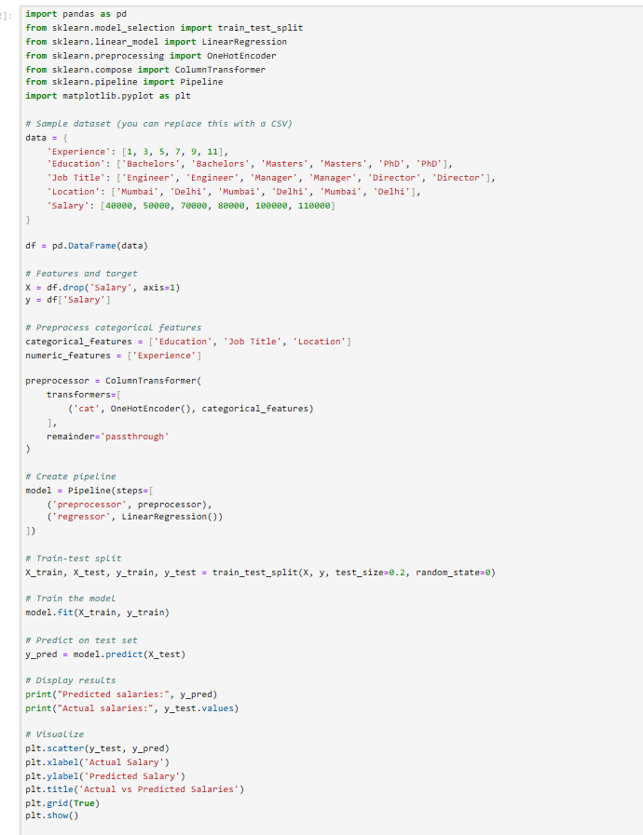
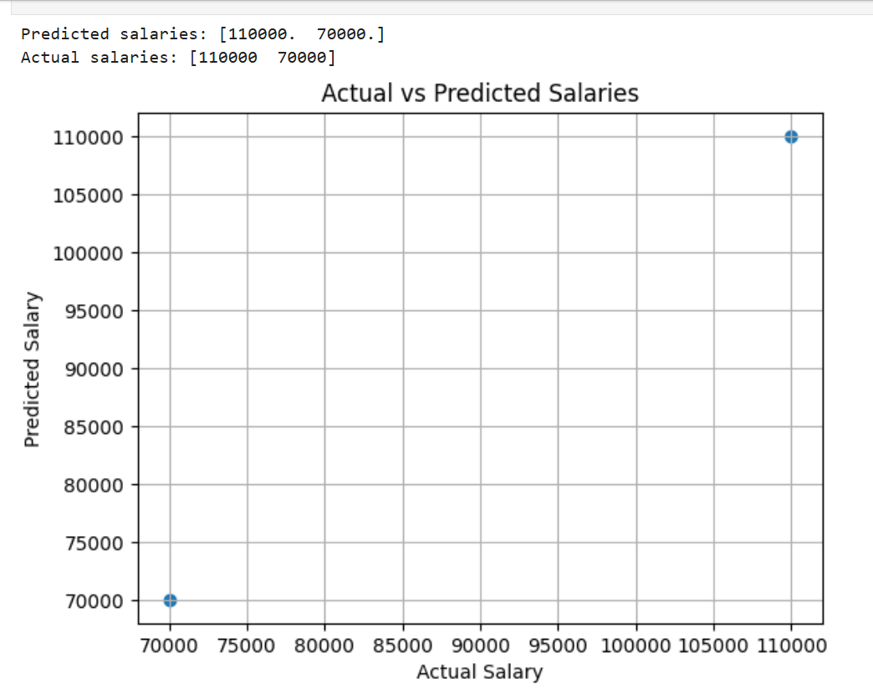
Result
https://github.com/HarshithaJyothula/employee-salary-using-ML
https://github.com/HarshithaJyothula

Slide 7
Conclusion
The Employee Salary Prediction project effectively demonstrated how machine learning can be used to estimate salaries based on features such as experience, education level, job title, and location. Using a Linear Regression model, the system provided reasonably accurate predictions and highlighted the potential for data-driven decision-making in HR practices. During the implementation, challenges such as finding a clean and comprehensive dataset, handling categorical variables, and avoiding overfitting were encountered. Despite these challenges, the model proved to be a practical and interpretable solution. Future improvements could include using more advanced algorithms like Random Forest or XGBoost, adding more features such as company size or skill set, and deploying the model through a user-friendly web interface for broader usability.

Slide 8
Future scope(Optional)
To enhance the accuracy and usefulness of the Employee Salary Prediction system, several improvements can be made. First, incorporating more advanced machine learning algorithms such as Random Forest, XGBoost, or Gradient Boosting can improve prediction performance by capturing complex patterns in the data. Additionally, expanding the dataset to include more diverse features like industry type, company size, employee skill set, and certifications can make the predictions more context-aware. Implementing a user-friendly web interface using frameworks like Flask or Streamlit would make the system accessible to HR personnel and recruiters without technical expertise. Furthermore, integrating real-time data input and automated model retraining can ensure the system stays updated with current market trends. Lastly, adding interpretability tools like SHAP or LIME can help users understand how different features impact salary predictions, making the system more transparent and trustworthy.

Slide 9
References
scikit-learn: Machine Learning in Python Pedregosa, F., Varoquaux, G., Gramfort, A., Michel, V., Thirion, B., Grisel, O., ... & Duchesnay, É. (2011). Journal of Machine Learning Research, 12, 2825-2830. https://scikit-learn.org
Hands-On Machine Learning with Scikit-Learn, Keras, and TensorFlow Géron, A. (2019). O'Reilly Media, 2nd Edition – Practical guide for applying ML models in real-world scenarios.
Kaggle: Salary Prediction Dataset Example datasets for salary prediction and regression problems. https://www.kaggle.com

Slide 10
THANK YOU

